Slide 1
Data Structures and Algorithms

Slide 2
Data Structures
static arrays
if sorted, supports binary search (O(log n))
linked lists - dynamic size
doubly-linked lists - easier deletion
queues - FIFO
stacks - LIFO
dequeues - double-ended queue - push/pop either end
maps - <key,value>
with hash tables, O(1) search, insert, delete

Slide 3
Binary Search Trees
each node holds a value, and has two subtrees
all values in the left subtree are smaller than the parent's value
all values in the right subtree are larger than the parent's value
Search is O(log2 n) if tree balanced
5
4
8
3
6
9

Slide 4

AVL Tree
binary search tree
height of subtrees of any node differ by at most one (balanced)
rebalance on insert/delete
5
5
3
insert 2
3
rebalance
3
2
5
2
balanced
unbalanced
balanced

Slide 5
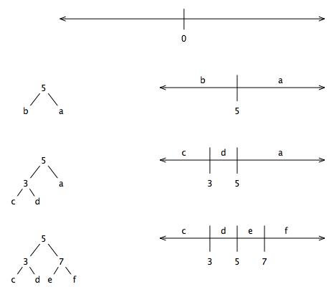
Binary search tree == 1-D spatial index
consider the number line
each tree node partitions the number line in two
leaves correspond to convex regions (connected line segments)

Slide 6
Searching a Binary Search Tree
def search(Tree, x):
"""returns leaf containing x"""
if Tree.isLeaf():
return Tree
elif x < Tree.value:
return search(Tree.leftChild, x )
else:
return search (Tree.rightChild, x )

Slide 7
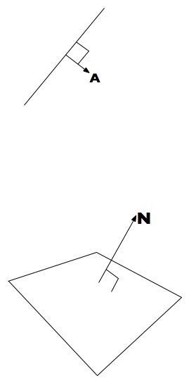
Binary Space Partitioning Tree
A BSP tree is a binary search tree for N-D space
Uses (N-1)-D linear splitting elements
2-D: lines
line equation:
ax + by + c = 0
Ax + c = 0
3-D: planes
plane equation:
ax + by + cz + d = 0
Nx + d = 0 (boldface used for vectors)
N = normal to plane
d = distance from origin
if Nx + d < 0, x is "behind" the plane
if Nx + d > 0, x is "in front of" the plane

Slide 8
Building a BSP Tree
def buildBSP ( faces ):
if len(faces) > 0:
splitter = chooseSplittingPlane(faces)
backFaces, inFaces, frontFaces = split(faces,splitter)
node = BSPTreeNode()
node.plane = splitter
node.polys = inFaces
node.leftChild = buildBSP(backFaces)
node.rightChild = buildBSP(frontFaces)
return node
else:
return BSPLeafNode()

Slide 9
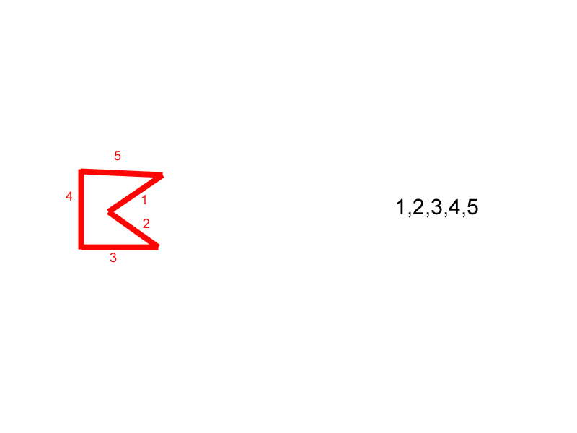
Building a BSP Tree

Slide 10
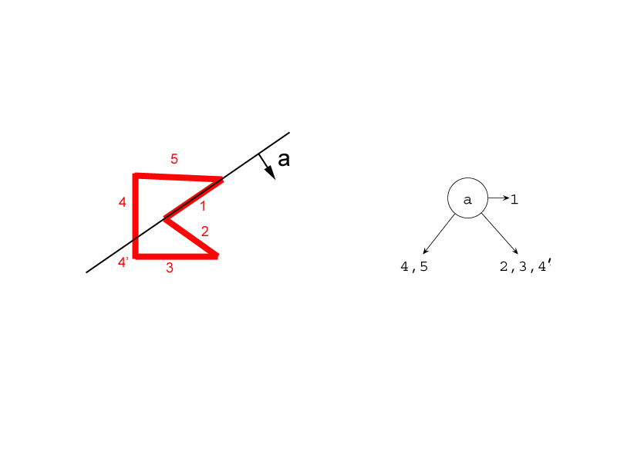
Building a BSP Tree

Slide 11
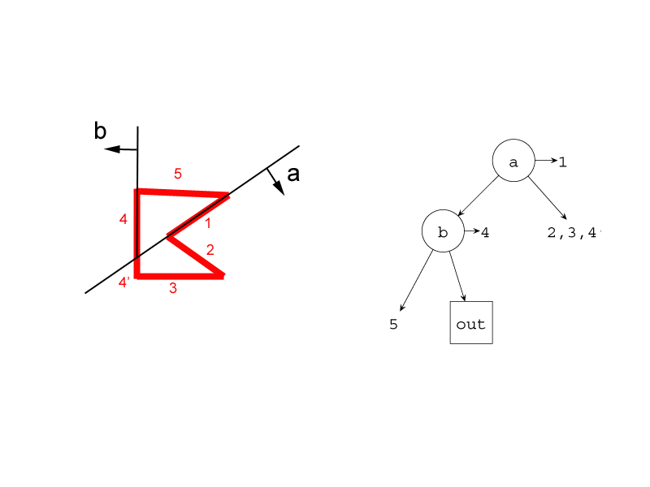
Building a BSP Tree

Slide 12
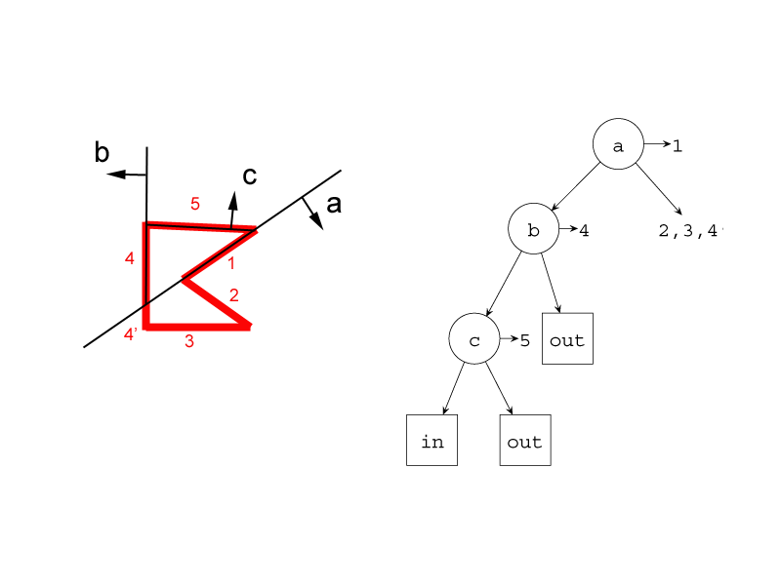
Building a BSP Tree

Slide 13
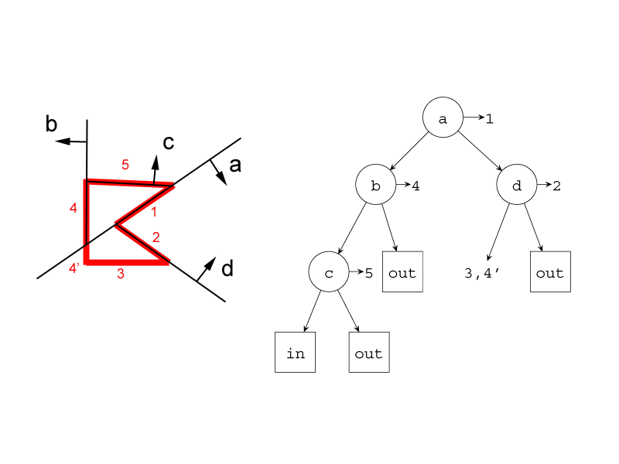
Building a BSP Tree

Slide 14
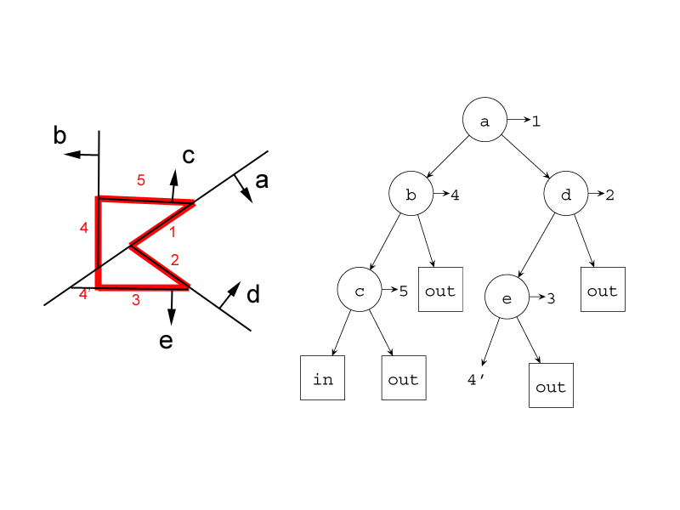
Building a BSP Tree

Slide 15
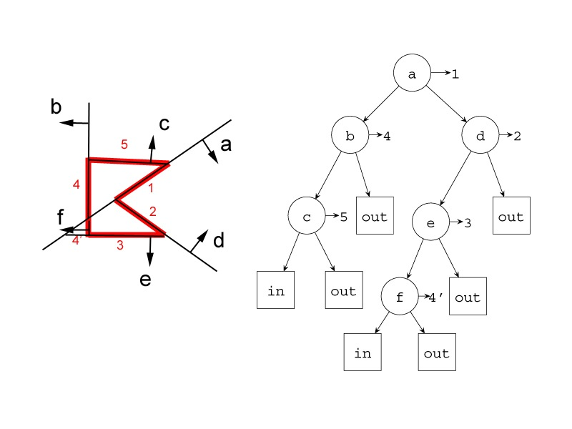
Building a BSP Tree
B
C
E
A
D
C
A
E
B
F
F
D

Slide 16
Searching a BSP Tree
Test if point x is "inside" or "outside" of the shape represented by a BSP Tree:
def searchBSP ( Tree, x ):
if Tree.isLeaf:
return Tree.label
dist = Tree.planeEquationAt(x)
if dist > 0:
return searchBSP ( Tree.rightChild, x)
else:
return searchBSP ( Tree.leftChild, x)

Slide 17
Rendering the Polygons in a BSP Tree
draw the in-plane polygons in back-to-front (or front-to-back) order with respect to viewpoint
a form of in-order traversal, where the order of visiting the subtrees depends on the the viewpoint's position with respect to the node's plane
def renderBSP ( Tree, viewpoint ):
if Tree.isLeaf:
return
dist = Tree.planeEquationAt(viewpoint)
if dist > 0:
nearSubtree = Tree.rightChild
farSubtree = Tree.leftChild
else:
nearSubtree = Tree.leftChild
farSubtree = Tree.rightChild
renderBSP ( farSubtree )
drawPolygons ( Tree.polys )
renderBSP ( nearSubtree )

Slide 18
BSP Tree Summary
BSP Trees can classify regions of space (eg as solid or empty)
speeds up collision tests
provide front-to-back or back-to-front orderings
are "global" - any change requires rebuilding tree
best for static elements

Slide 19
Quadtrees
each level of the quadtree subdivides space into 4 square regions
each region is recursively subdivided, as needed
leaf nodes of quadtree correspond to regions
terminate subdivision when a region is "simple enough" (eg, has < n objects)

Slide 20


Slide 21
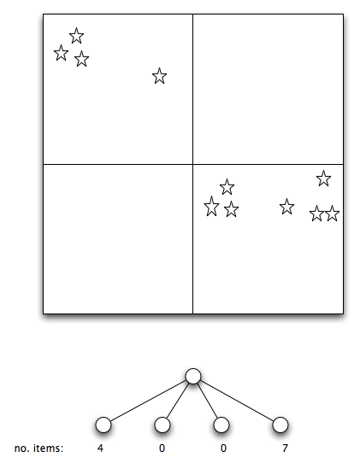

Slide 22
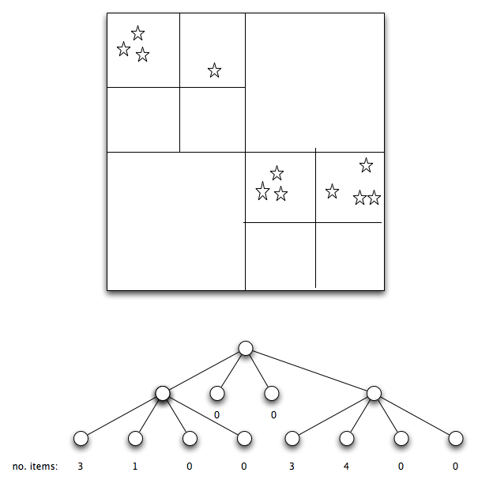

Slide 23
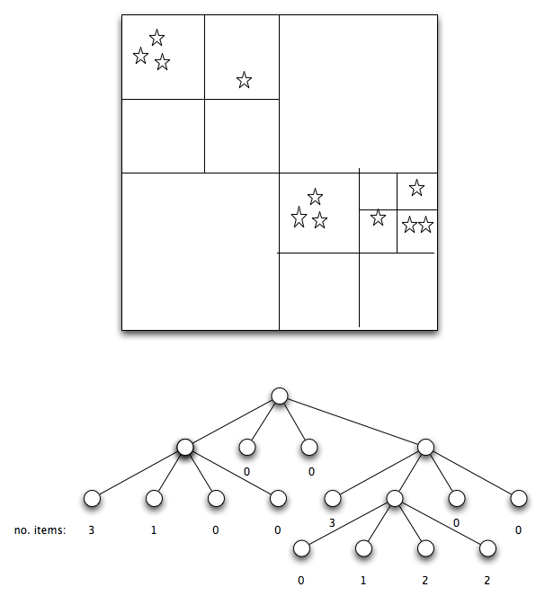
Quadtrees

Slide 24
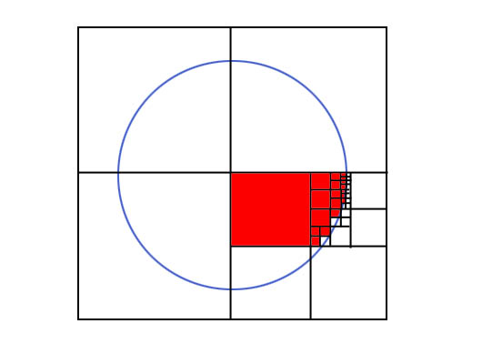
http://groups.csail.mit.edu/graphics/classes/6.837/F98/talecture/

Slide 25
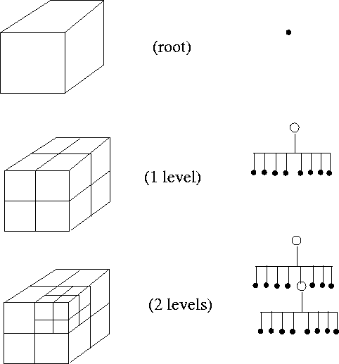
Octree
"3-D quadtree"
each non-leaf node has 8 children
http://groups.csail.mit.edu/graphics/classes/6.837/F98/talecture/

Slide 26
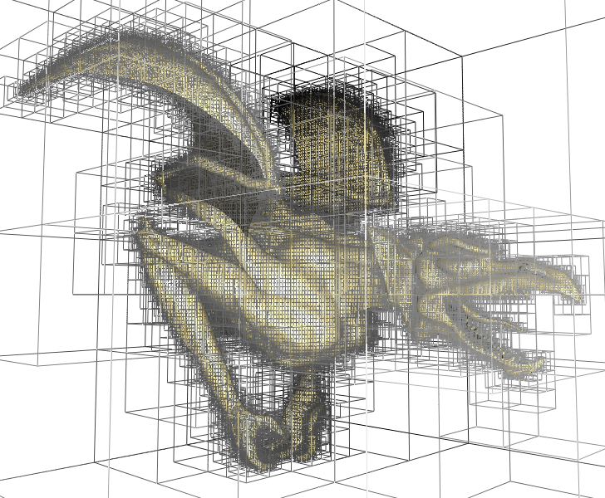
http://www-evasion.imag.fr/Membres/Sylvain.Lefebvre/pict1.png

Slide 27
Spatial Subdivision
regular subdivision
squares, cubes
may have many empty regions
easy to find in which region a point lies
adaptive subdivision
BSP Trees, quadtrees, octrees
can be less verbose than regular subdivisions
can cost more to search than regular subdivisions

Slide 28
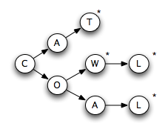
Others
tries - branching based on representation
priority queue - find "largest" element in O(1) time
graphs
G = { N, E }
N = nodes
E = edges (n1, n2)

